Slide 1
End to End Data Engineering pipeline using NYC Taxi data
Team Members:
Mahmoud Ahmed Elsayed Mohamed Hassanen
(Faculty of Engineering Alexandria University)
Marwan Atef Moham
(FCI Fayoum University)
Abdelrahman Mohammed Fathi
(E-JUST Egypt Japan university of science and technology)
Mohammad Hisham Hamza
(E-JUST Egypt Japan university of science and technology)

Slide 2
Project overview
This project demonstrates a comprehensive end-to-end data pipeline for processing taxi data utilizing various Azure services, including Data Lake Storage, Data Factory, Databricks, Synapse Analytics, and Azure Machine Learning. The pipeline automates the Extract, Load, and Transform (ELT) processes, enabling insightful analysis and predictive modeling.

Slide 3
Data Collection and Integration
Data Source:
Gathered real-world data from Kaggle (NYC dataset).
Data Enrichment:
Applied Faker script to generate additional data
Data Loading:
Load the data into flat file

Slide 4
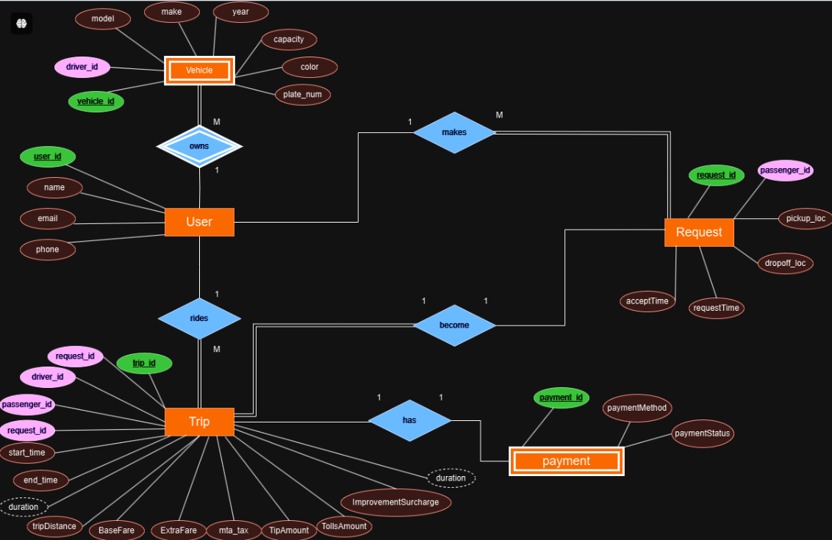

Slide 5
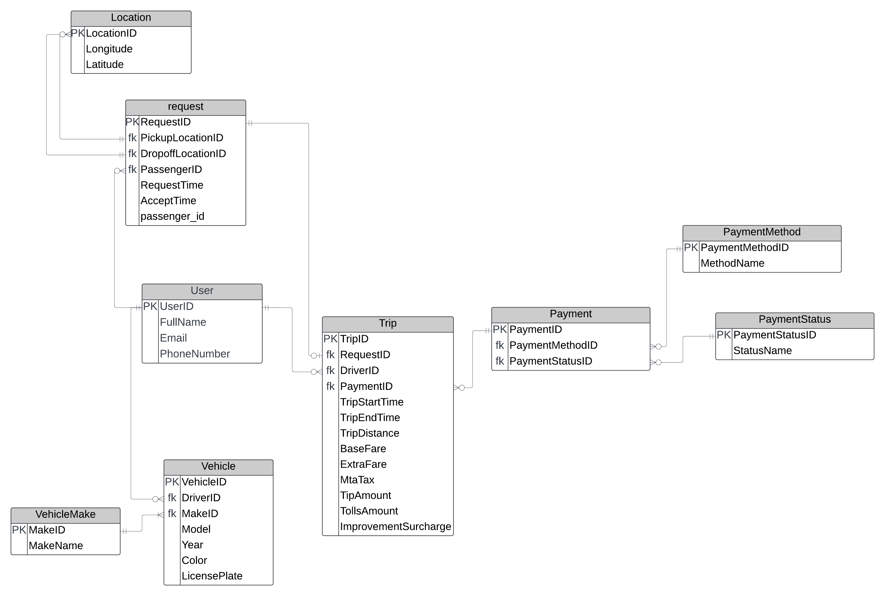

Slide 6
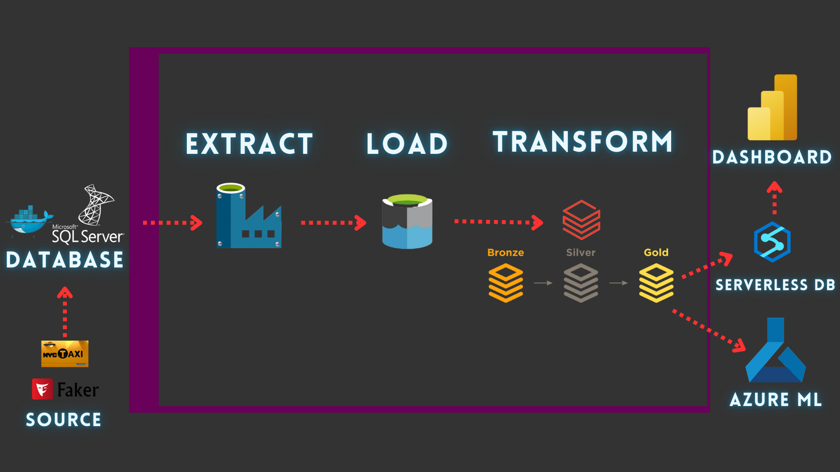
From local to azure

Slide 7
Key objectives
Data Ingestion: Implement an efficient pipeline using Azure services to ingest data from the NYC Taxi dataset and Docker-hosted Uber database.
Data Processing: Transform and clean the data using a Medallion architecture (Bronze, Silver, and Gold layers).
Data Analysis: Analyze user behavior, trip performance, and fare trends to derive actionable insights.

Slide 8
Architecture Overview
Components:
Architecture Overview:
SQL Server Container: Hosts database, performs bulk inserts and transformations.
Jupyter Notebook Container: Provides environment for data exploration and transformation with Apache Spark.
Shell/PowerShell Export Containers: Export transformed data to CSV format.
Apache Airflow: Orchestrates the ETL process, ensuring step-by-step execution of the workflow.
Docker-Containerized Setup: Ensures portability and ease of deployment across environments.

Slide 9
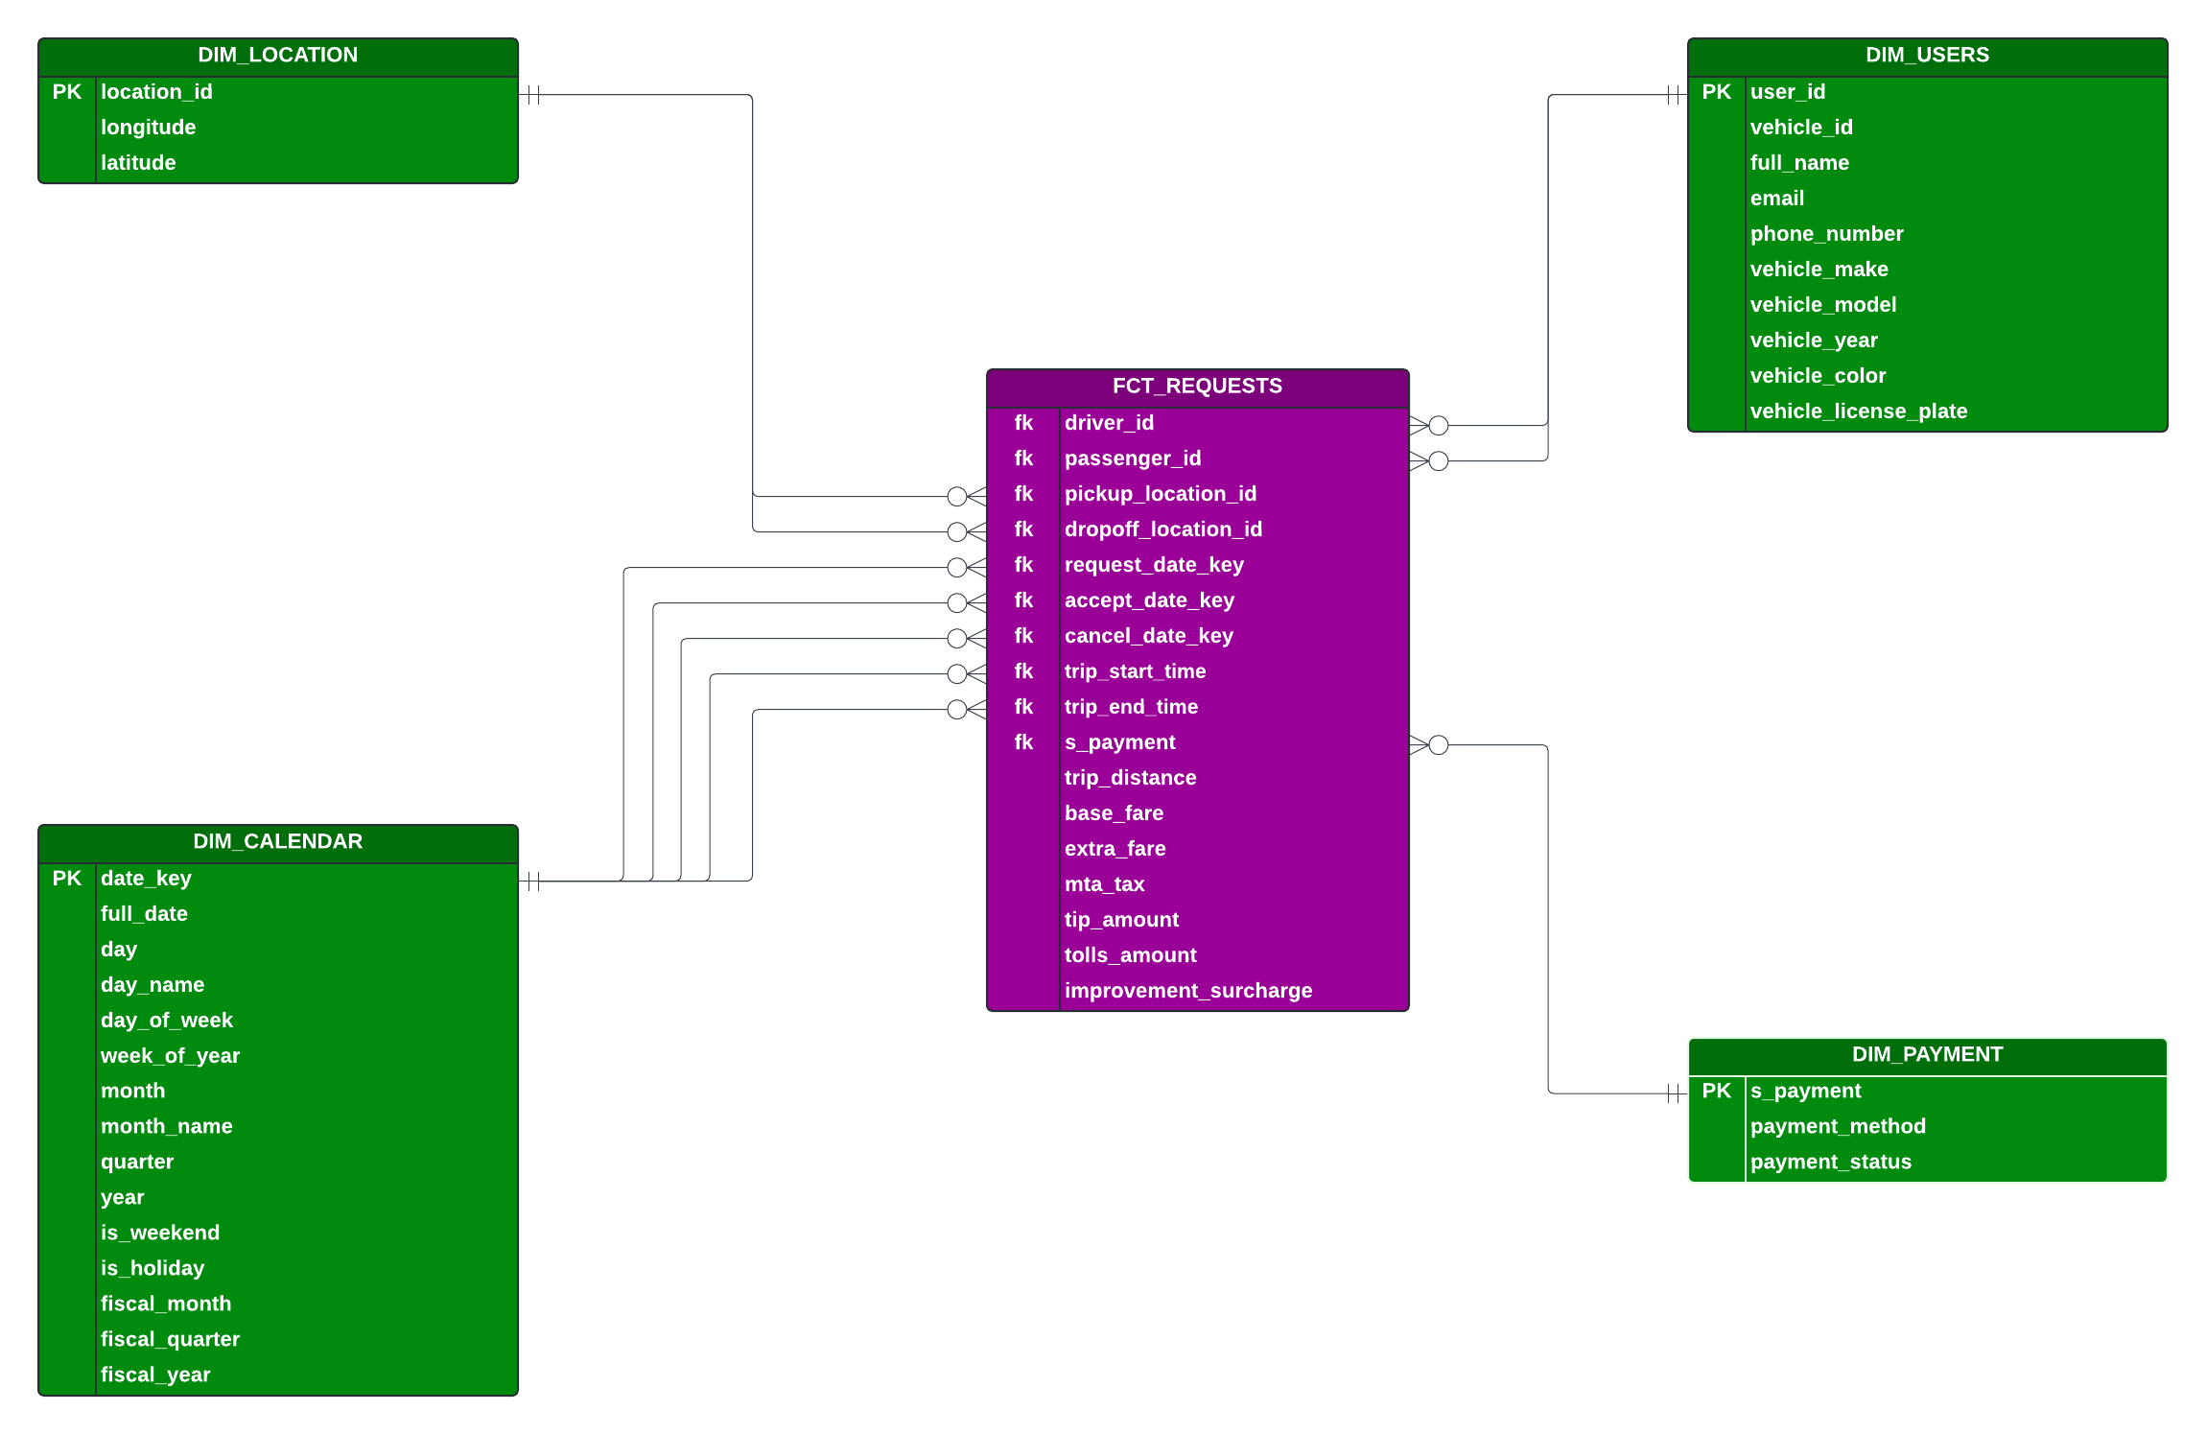
Datawarehouse design

Slide 10
Project Folder Structure
SQL-image : SQL Server container setup and SQL scripts
Notebook-image : Jupyter notebook container for data processing.
Shell-image : Shell script container for exporting data to CSV.
Powershell-image : PowerShell container for environments requiring PowerShell.
Airflow : DAG setup for Apache Airflow orchestration.
docker-compose.yml : Manages Docker services across the entire project.

Slide 11
Machine learning model
Project Overview:
Building a machine learning model to predict the base fare for a transportation service based on trip distance.
Data stored in Delta Lake and processed in a Spark environment using PySpark.
Data Sources:
Fact Table: Contains trip details such as distance, pickup and dropoff times, fare amount, and payment types.
Dimension Tables: Include user details, payment methods, and locations.

Slide 12
Data Preprocessing and Feature Engineering
Data Cleaning:
Removed null values, handled outliers, and ensured data consistency.
Feature Selection:
Key feature: trip_distance.
Target variable: base_fare.
Splitting Data:
Training Set: 80% of the data.
Test Set: 20% of the data.

Slide 13
Modeling and Performance Evaluation
Model Used:
Linear Regression model fitted to the training data.
Performance Metrics:
Root Mean Squared Error (RMSE): 2.59.
Coefficient of trip_distance: 2.765.
Model Saving:
Saved the trained model as model.pkl for deployment.

Slide 14
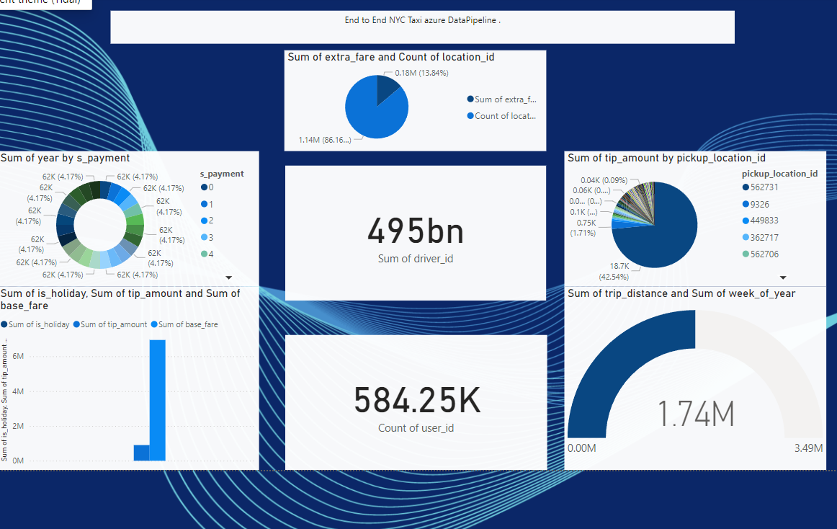
POWER BI Dashboard

Slide 15
Deployment and Future Work
Model Deployment:
Create two notebooks on azure databricks to deploy the model
Python script used in machine learning projects, especially when deploying

Slide 16
Thanks feel free to contact with us: mouda4d@gmail.com

